Slide 1
Damage Propagation Modeling for Aircraft
Engine Run-to-Failure Simulation
Sankalp Agrawal

Slide 2
Overview
This paper describes how damage propagation can be modeled within the modules of aircraft gas turbine engines.
Response surfaces were generated for all sensors via a thermo-dynamical simulation model for the engine as a function of variations of flow and efficiency of the modules of interest.
A health index was defined as the minimum of several superimposed operational margins at any given time.
The data generated were used as challenge data for the Prognostics and Health Management (PHM) data competition

Slide 3
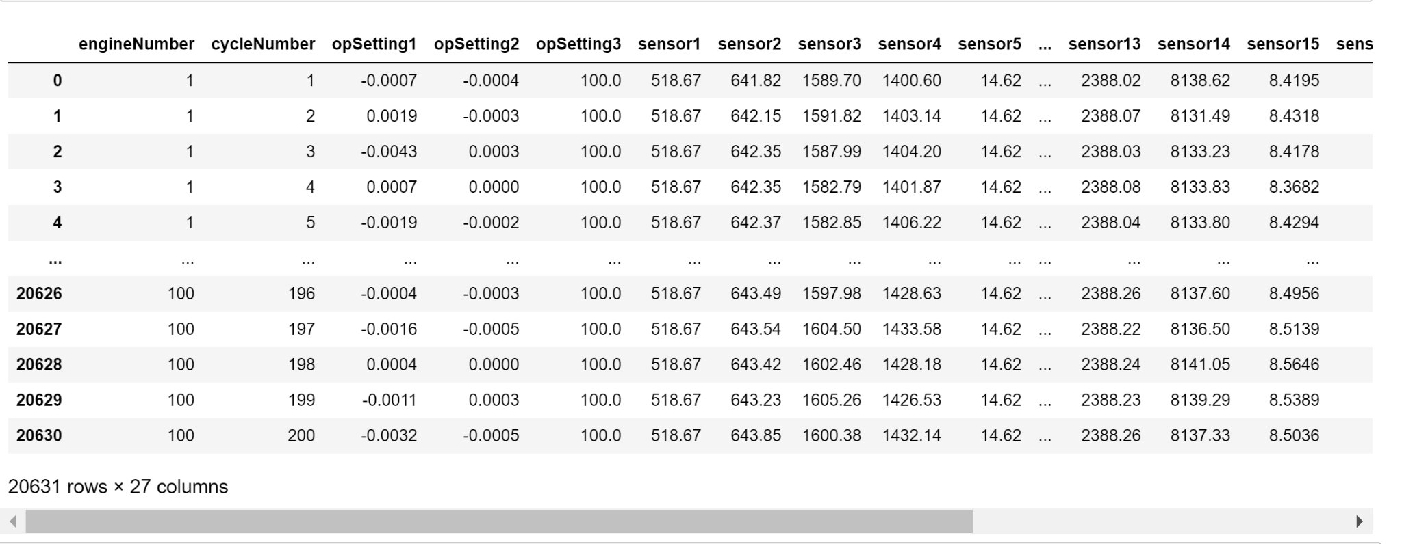
Dataset Used: FD001
Imported the dataset train_FD001, test_FD001 & rul_FD001 on the jupyter notebook.
Dataset rul_FD001 was integrated into dataset train_FD001 and data analysis was conducted.
Total unique engines present in the data were 100.

Slide 4
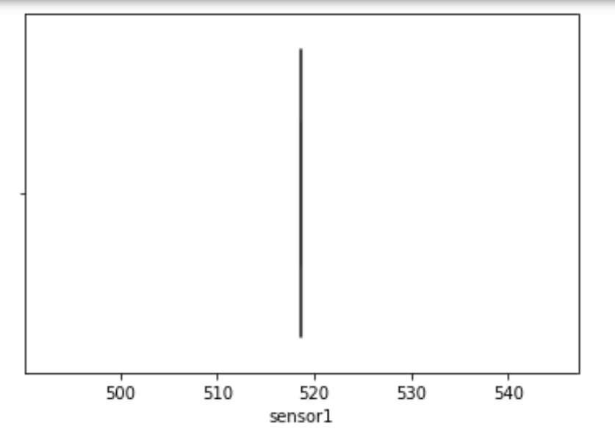
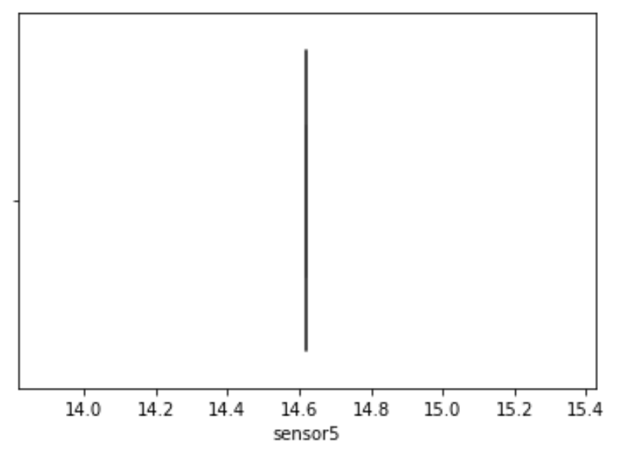
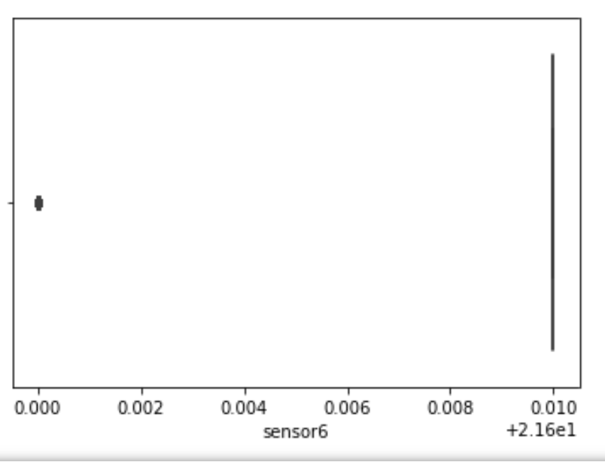
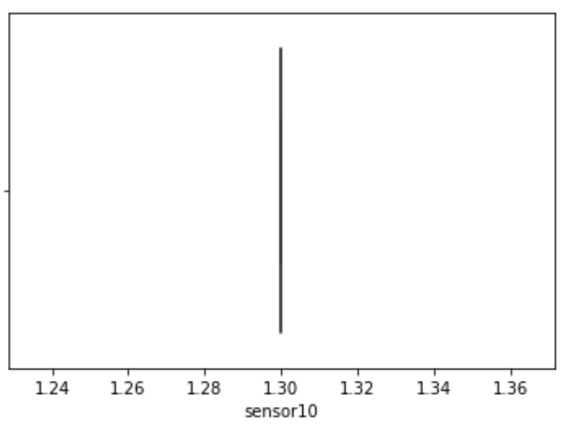
By analysing with the help of boxplot and taking the info of sensor dataset, it was found out that sensors 1, 5, 6, 10, 16, 18, 19 should be removed as they produce no variation.

Slide 5
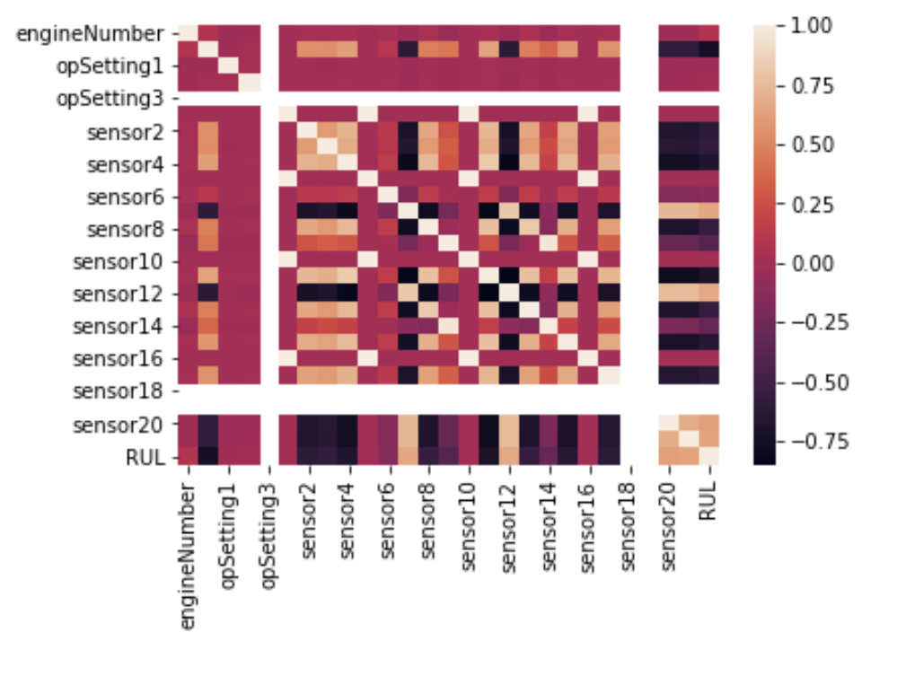
Heatmap of correlation of sensors

Slide 6
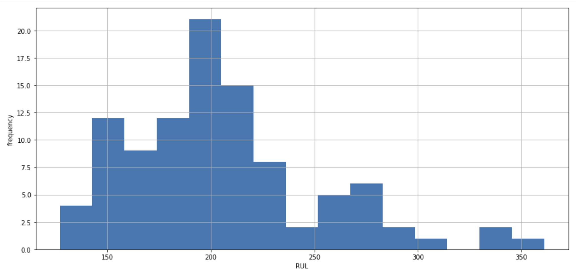
Frequency of engine breakdown
This represents that most of the engines breakdown at around 200 cycles.

Slide 7
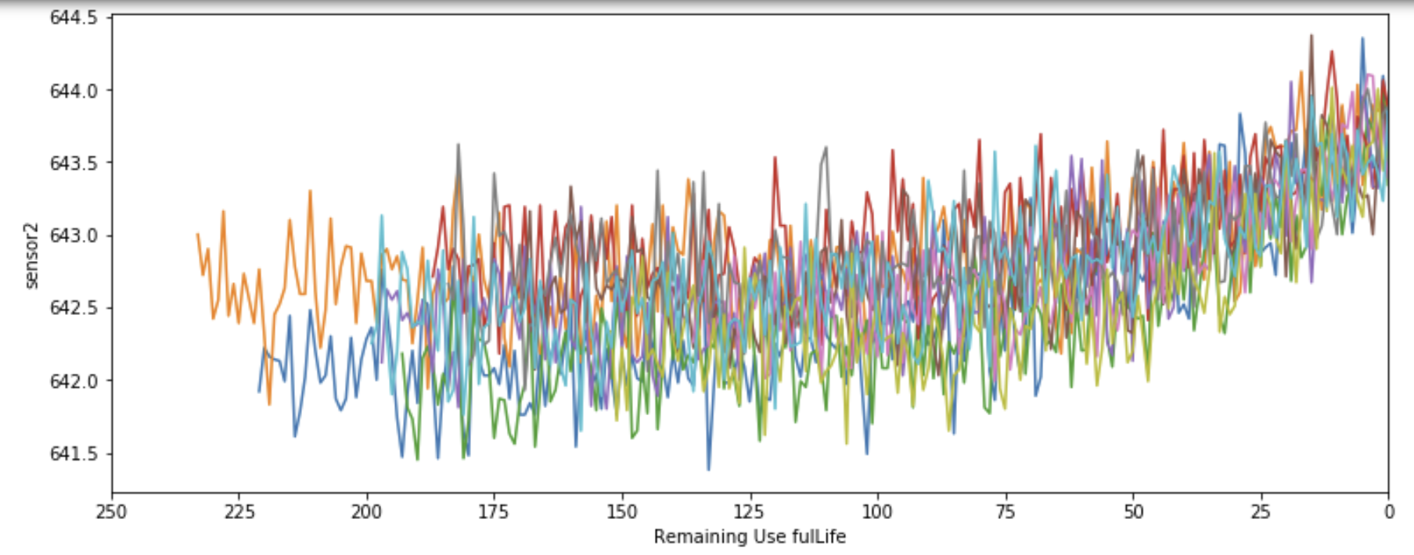
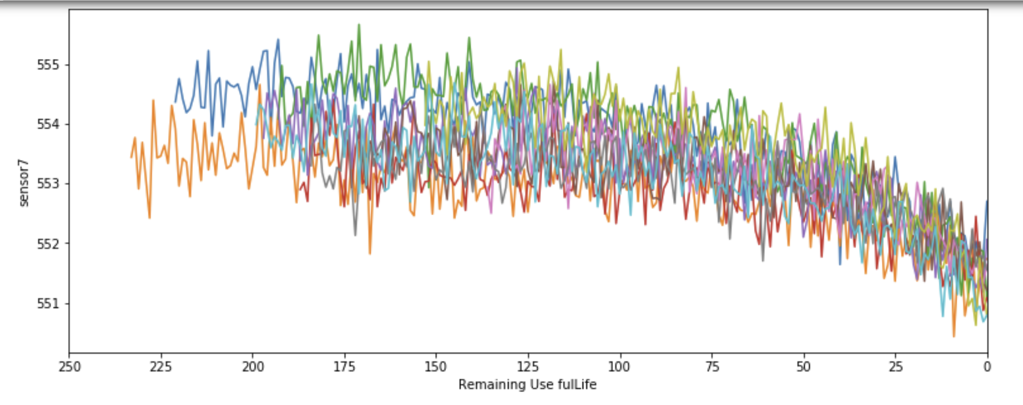
Plotted the graph of sensors vs Remaining Use life(RUL)

Slide 8
After performing Exploratory Data Analysis, I trained linear regression model on train_fd001 dataset
Achieved an RMSE of 39.58 and
R2_score of 0.6697
After using Linear regression model, i tried using Decision Tree regressor to improve my model with criteria like:
criterion='mse'
max_depth=7
random_state=1
After using decision tree regressor, i achieved RMSE of 30.4126 and
R2_Score of 0.8050

Slide 9
Predicted RUL of test dataset:
And then using DTR model, i predicted the RUL of test dataset
array([194.86309524, 126.02889246, …………... 120.22818792, 96.8447205 , 151.96884735, 14.35 ])

